Slide 1

Stage 1 PCSL 2024:1_2 The Standards Course Designer: PCSL Classifier Team
Carbine: 16 Handgun: 16
The start position is standing anywhere in rear shooting area. Handgun is loaded and holstered. Carbine is loaded, stock on belt, safety on.
On the audible start signal, engage left Carbine paper targets and 4 Carbine Clay Pigeons from the left of the wall and right Carbine paper targets and the remaining 4 Carbine Clay Pigeons from the right of the wall. Abandon Carbine. Then engage left Handgun steel from the left of the wall and right Handgun steel from the right of the wall. Then engage all Handgun paper targets and re-engage all Handgun steel from Box A. Competitor’s choice which side of wall to engage from first. Reload required with Carbine between first & last shot. Reload required from Handgun between first & last shot. .

Slide 2
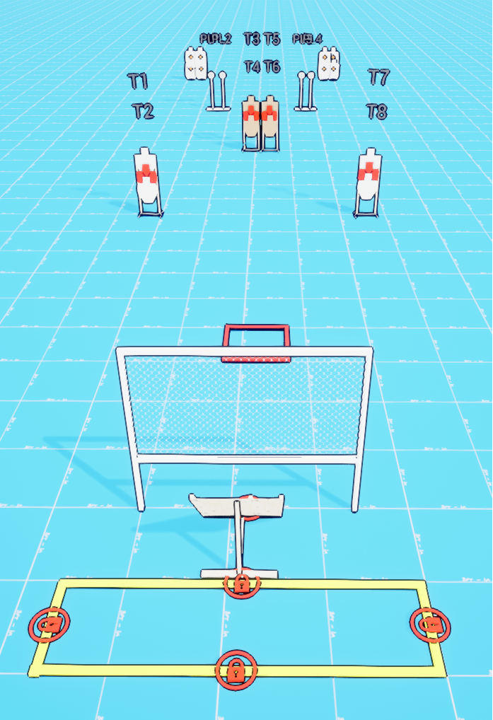
 | Stage 1 PCSL 2024:1_2 The Standards Course Designer: PCSL Classifier Team

